Slide 1
Entity relationship model => relational diagram
The relational model is the second step in database deseigning, it consists on converting the conceptual model(the Entity-relationship model) to a relational model based on several rules,

Slide 2
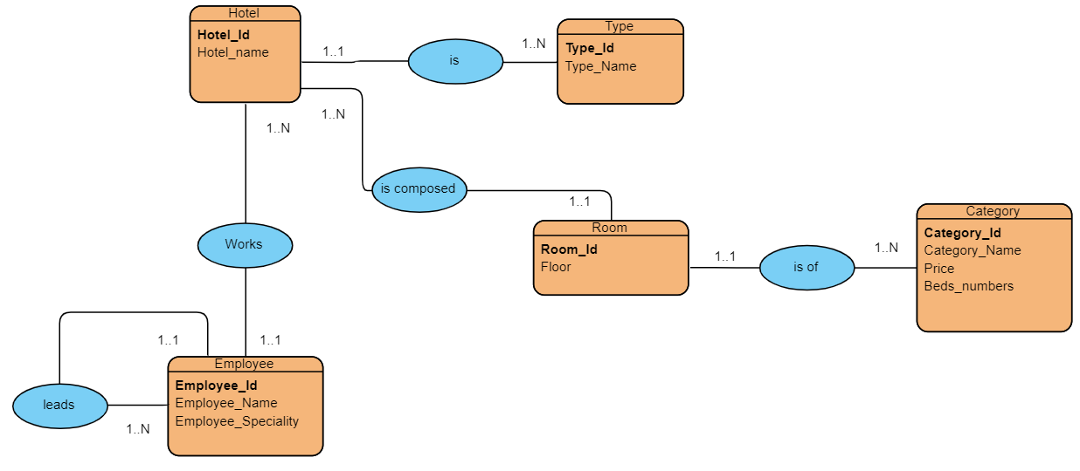
conception of the relationship model

Slide 3
Mapping rules: onetomany
ER Model:
Hotel (Hotel_id, Hotel_Name,#Type_id)
Type (Type_id, Type_Name)
Relational Model:

Slide 4
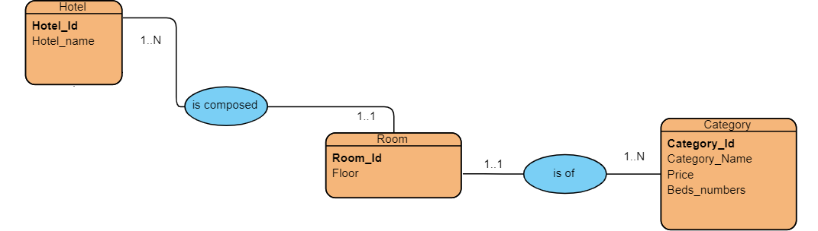
Mapping rule: relation manytomany
ER Model:
Hotel (Hotel_id, Hotel_name, #Type_id)
Room (Room_id, Floor, #Hotel_id, #Category_id)
Relational Model:

Slide 5
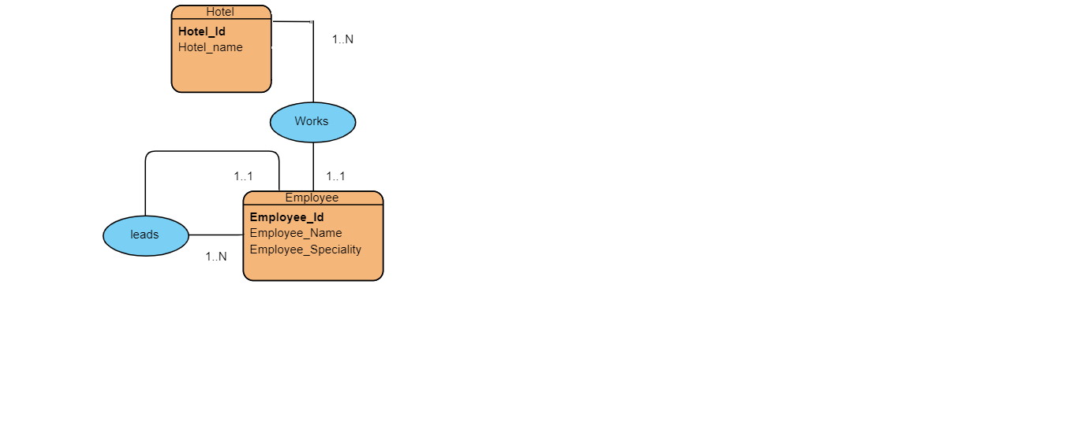
Mapping rule : Reflexive relation
ER Model:
Relational Model:
Employee (Employee_id, Employee_Name, Employee_Speciality, #director_id)

